Slide 1
Monthly Report / Balancing
SAF School Accounting

Slide 2
Agenda
How to Run the 19 - Budget Report
How to Run the 56 - Cash Receipts Report
How to Run ZMM97TD - Open PO Reports
How to Complete Monthly Report via Cognito
Additional Forms Needed Overview (2nd Training)
2

Slide 3
OSSBA - School Activity Funds Management Regulation Policy
Policy's are located on OKCPS.com > Board of Education > Board Policy> C-08-R1

Slide 4
19 Actual vs Budget (annual) Report
T Code: Y_OKD_48000019
Fund Is Always 60801 to 60999
Funds center is your 3 digit site number
Variant always EXP
Fiscal Year 2025 (This will change each year).
Always use From period 1 to period 12
Clock to run report - this will take a few minutes to run.
12

Slide 5
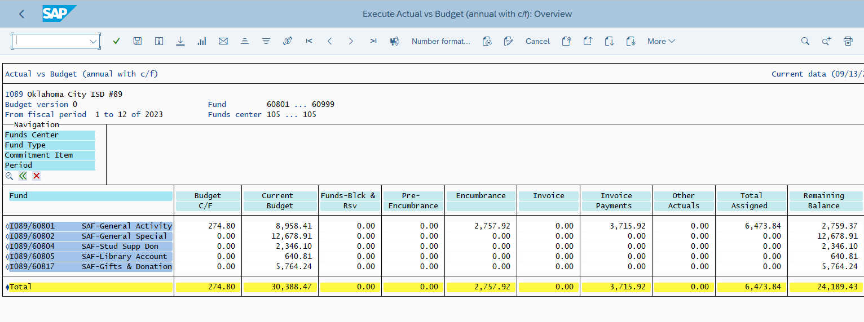
Viewing the 19 Report (Cont’d)
Below is the 19 Report and School Site’s Cost Centers
Pre-Encumbrance (purchase requisitions), Encumbrances (purchase orders), Accounts Payable (“to be paid”) and Payments Issued (have been paid). The budget minus these items will provide you with a “ Remaining Balance”
5

Slide 6
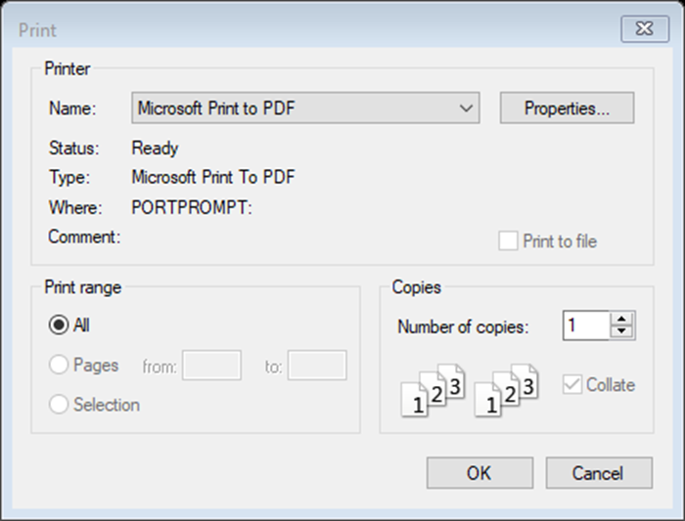
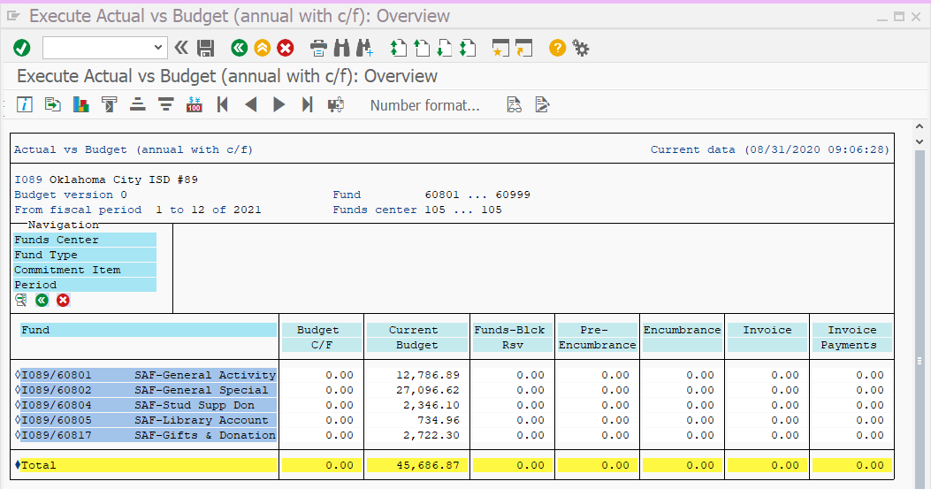
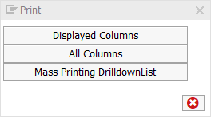
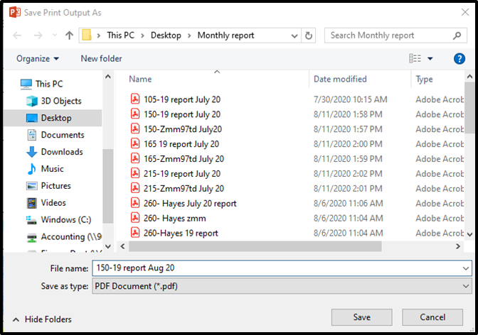
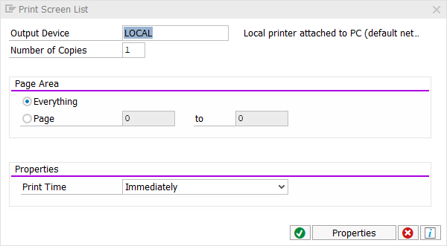
Saving the 19 Report (Cont’d)
Step 1- Click the printer icon
Step 2- Choose All Columns
Step 3- Click the green check mark on the ALV List
Step 4- Change Name to Microsoft Print to PDF and OK
Step 5- Save your 56 report to your desktop, rename to 19 report and save
6

Slide 7
56 Cash Journal Report
T Code: Y_OKD_48000056
Company Code: I089 (always)
Document Type: CJ (always)
Fiscal Year: current FY
Fiscal period: put in the number to the month you want or leave blank for the whole year
Business area: 60
Funds center: Site number
Remove your Name from SAP user ID
Uncheck include parked documents
Click the clock to run the report (top left)
1-July 7-January
2-August 8-February
3-September 9-March
4-October 10-April
5-November 11-May
6-December 12-June
7

Slide 8
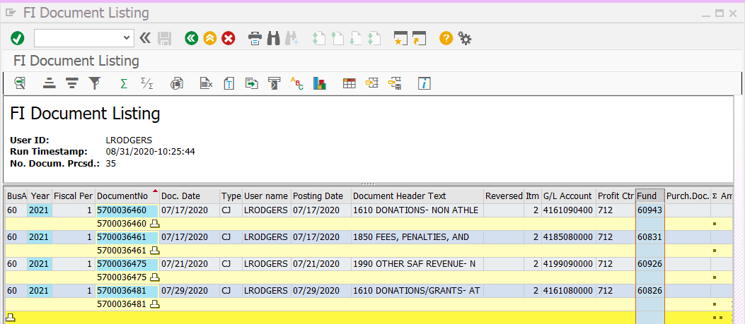
Viewing the 56 report (Cont’d)
To view the cost centers in numerical order and totals for each CC.
1. Click to highlight the Fund column
2. Click the E/E icon
Now you can see what was receipted to your different cost centers for your Profit/Loss form and Monthly Balancing

Slide 9
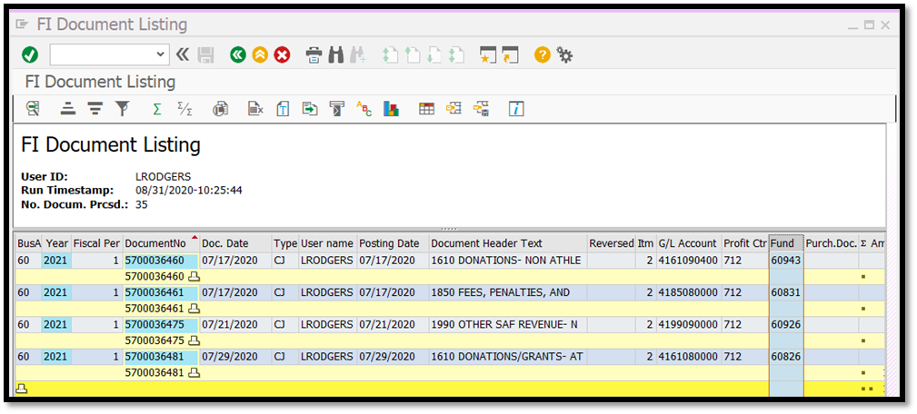
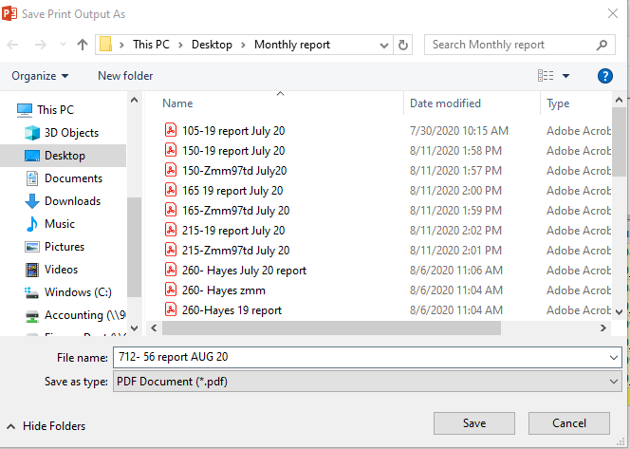
Saving the 56 Report (Cont’d)
Step 1- Click the printer icon
Step 2- Click the green check mark on the ALV List
Step 3- Change Name to Microsoft Print to PDF and OK
Step 4- Save as site/report/month

Slide 10
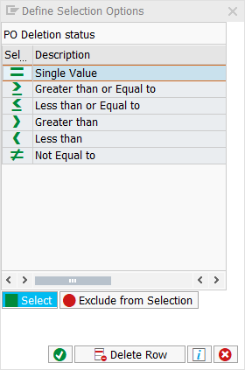
ZMM PO Status Report
T Code: ZMM97TD
PO Deletion Status- Double Click choose = Single value, Click green check mark
Fund Center is your Site Number
PO Number
SAF- 4925000000 to 4925999999
All other funds- 4525000000 to 4525999999
Red numbers indicate FY this will change each year
Click the clock
10

Slide 11
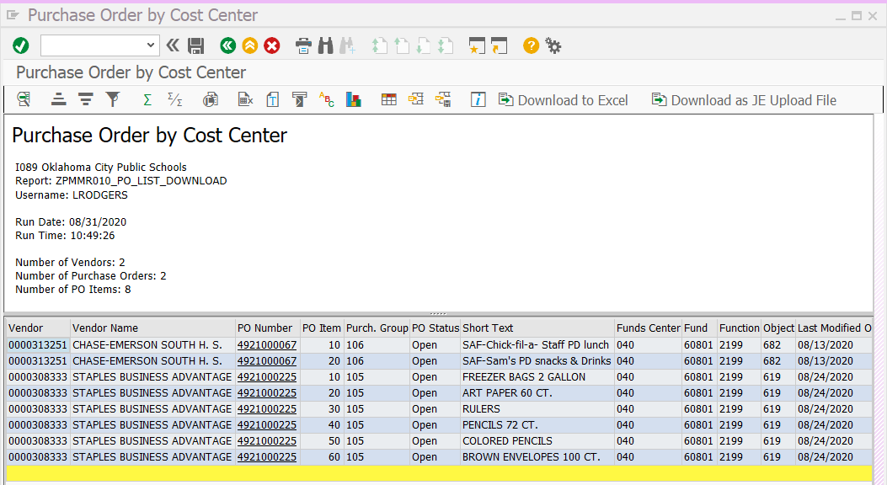
Viewing the ZMM Report (Cont’d)
By clicking the PO Number it will open that PO to view.
If a PO is older than the current month of your report; call the vendor to check the status of the order. PO’s should not be left open all year!

Slide 12
Saving the ZMM Report (Cont’d)
Step 1- Click the printer icon
Step 2- Click the green check mark on the ALV List
Step 3- Change name to Microsoft Print to PDF and click OK
Step 4- Save your Zmm97td report to your desktop, rename to Zmm report and Save

Slide 13
Monthly Reporting via Cognito
Can begin on the 1st of each month, due by the 10th.
The report is on OKCPS.org >School Accounting webpage via Cognito
11th a past due email will be sent to the Financial Secretary (FS)
15th an email will be sent to the FS and Principal
17th sent to FS, Principal and PS Cost Centers can be put on HOLD for spending until forms are submitted!

Slide 14
Go to the form and walk through together SAF Monthly Report
Located on the School Accounting webpage
Due monthly by the 10th!
After the form is approved by the site principal, a copy will be emailed to the financial secretary to update records. Keep this email for records.

Slide 15
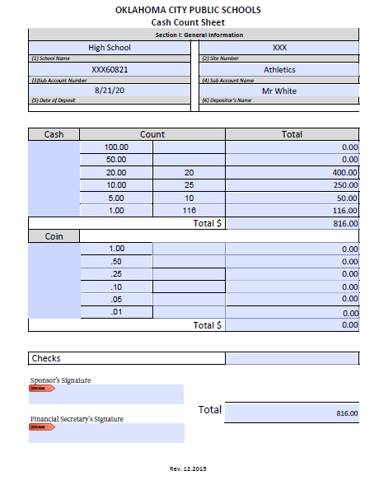
Cash Count for Athletic Change
Middle School and High School that have the athletic change fund (given at the beginning of the school year) will complete this form to attach with the Monthly Report. Date must be the last day of that reporting month!
Money will be deposited after the last game in the Spring.
Make sure the deposit slip states it is Athletic Change funds. You do not need to record it in FBCJ!

Slide 16
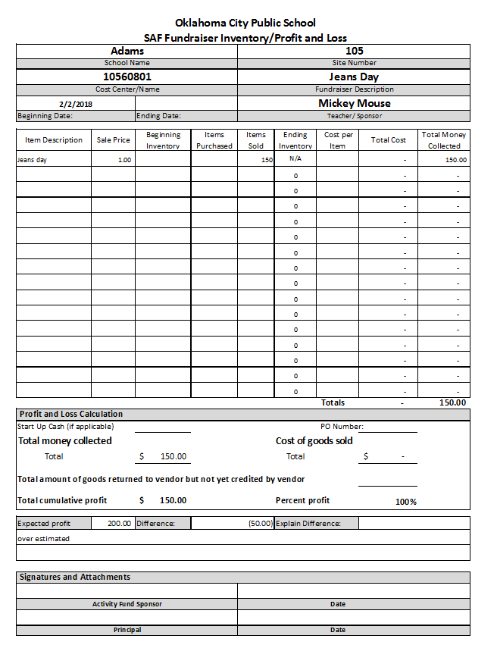
SAF Fundraiser Inventory/Profit and Loss
This form will correspond with the 56 Report. This is a different training!
Anything that is coded 1950 or 1890 will need a IPL completed by the sponsor.
Anything coded 1830 or 1930 concessions will need this inventory filled out.
Anything coded 1810 or 1910 Admission will need a Ticket Sales.
The Inventory/Profit & Loss (IPL) form can be found on the School Accounting webpage.
16

Slide 17
Questions?

